Slide 1



Quantum engineering following nature’s lead: using genetic algorithms to develop nitride optoelectronic nanodevices
Adrian Luna
Dr. Inès Montaño
Northern Arizona University

Slide 2
Quantum engineering following nature’s lead: using genetic algorithms to develop nitride optoelectronic nanodevices

Slide 3
Optoelectronics...WHAT?!?!
Quantum engineering following nature’s lead: using genetic algorithms to develop nitride optoelectronic nanodevices

Slide 4
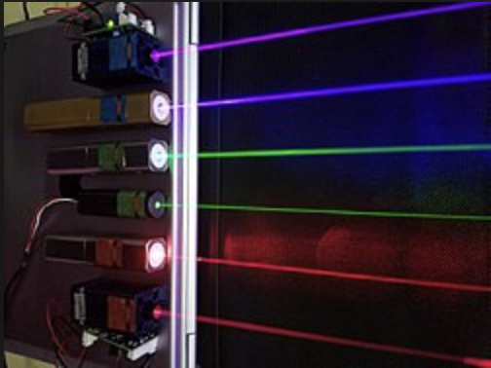

Quantum engineering following nature’s lead: using genetic algorithms to develop nitride optoelectronic nanodevices
Optoelectronic devices: devices that either absorb or emit light.

Slide 5
Quantum engineering following nature’s lead: using genetic algorithms to develop nitride optoelectronic nanodevices

Slide 6
The devices of interest
Quantum engineering following nature’s lead: using genetic algorithms to develop nitride optoelectronic nanodevices
semiconductor layer structures
with characteristic lengths of
100 nm or below
Material 2
Material 1
Material 1
1nm - 100nm

Slide 7
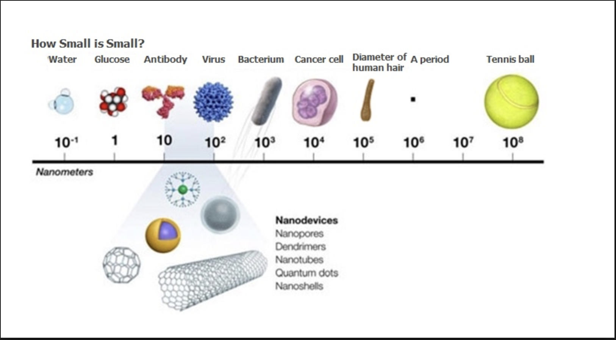
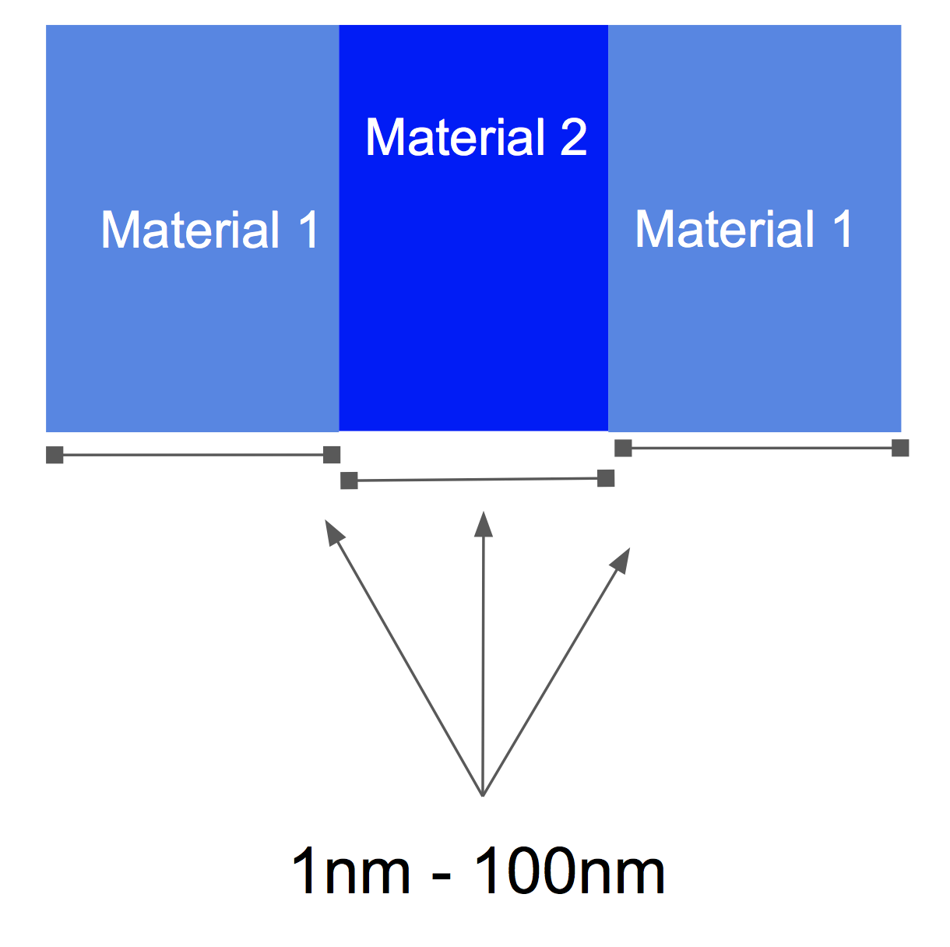
NANO-SIZE!!
Quantum engineering following nature’s lead: using genetic algorithms to develop nitride optoelectronic nanodevices

Slide 8
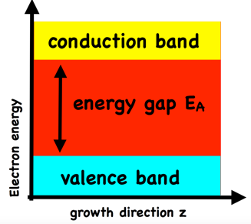
Quantum engineering following nature’s lead: using genetic algorithms to develop nitride optoelectronic nanodevices
semiconductor layer structures
with characteristic lengths of
100 nm or below
Material 2
Material 1
Material 1
1nm - 100nm

Slide 9
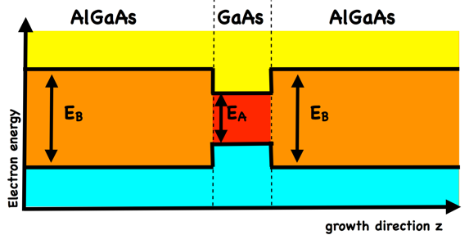
Layering different semiconductor materials...
Quantum engineering following nature’s lead: using genetic algorithms to develop nitride optoelectronic nanodevices

Slide 10
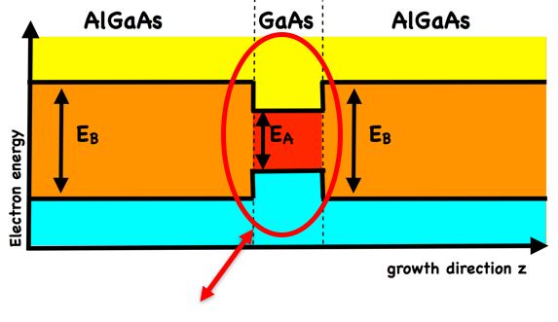
Layering different semiconductor materials...
Quantum engineering following nature’s lead: using genetic algorithms to develop nitride optoelectronic nanodevices
1d quantum well with discrete energy eigenstates

Slide 11
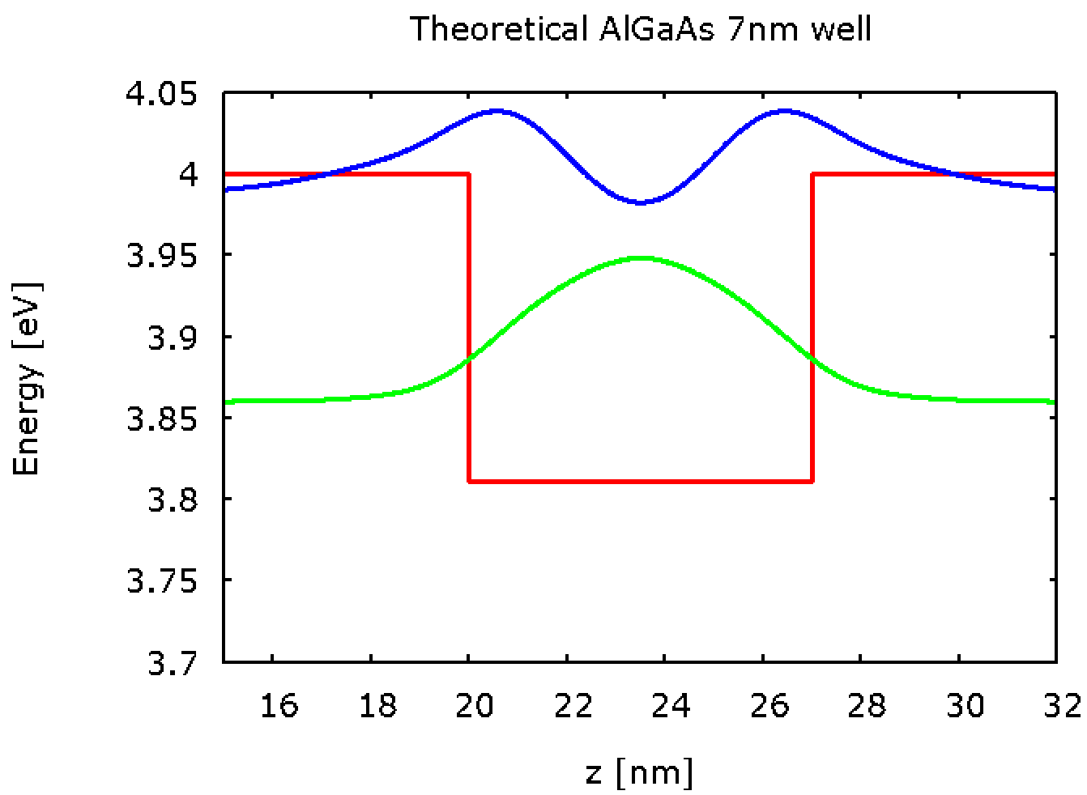
A simulated well / arsenic example
Quantum engineering following nature’s lead: using genetic algorithms to develop nitride optoelectronic nanodevices
AlGaAs
GaAs
AlGaAs

Slide 12
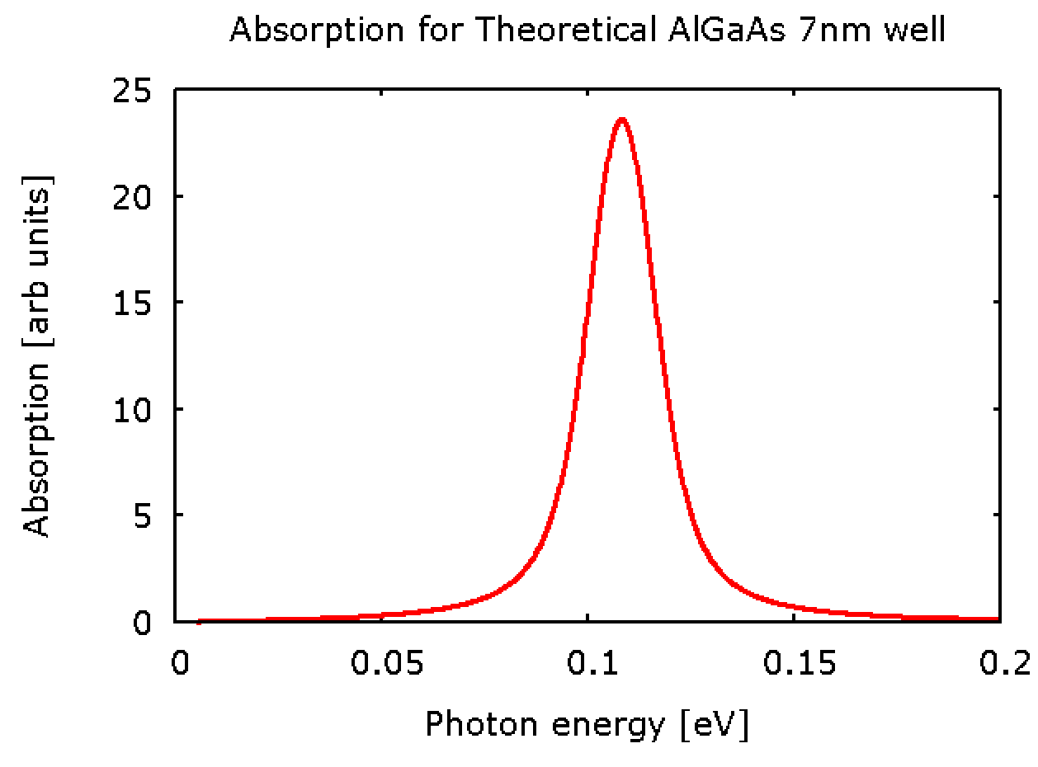
A simulated absorption / arsenic example
Quantum engineering following nature’s lead: using genetic algorithms to develop nitride optoelectronic nanodevices

Slide 13
They match!!!
Quantum engineering following nature’s lead: using genetic algorithms to develop nitride optoelectronic nanodevices
~ 0.12 eV
AlGaAs
GaAs
AlGaAs
Same Energy value

Slide 14
Quantum engineering following nature’s lead: using genetic algorithms to develop nitride optoelectronic nanodevices

Slide 15
So...why nitride?
Quantum engineering following nature’s lead: using genetic algorithms to develop nitride optoelectronic nanodevices

Slide 16
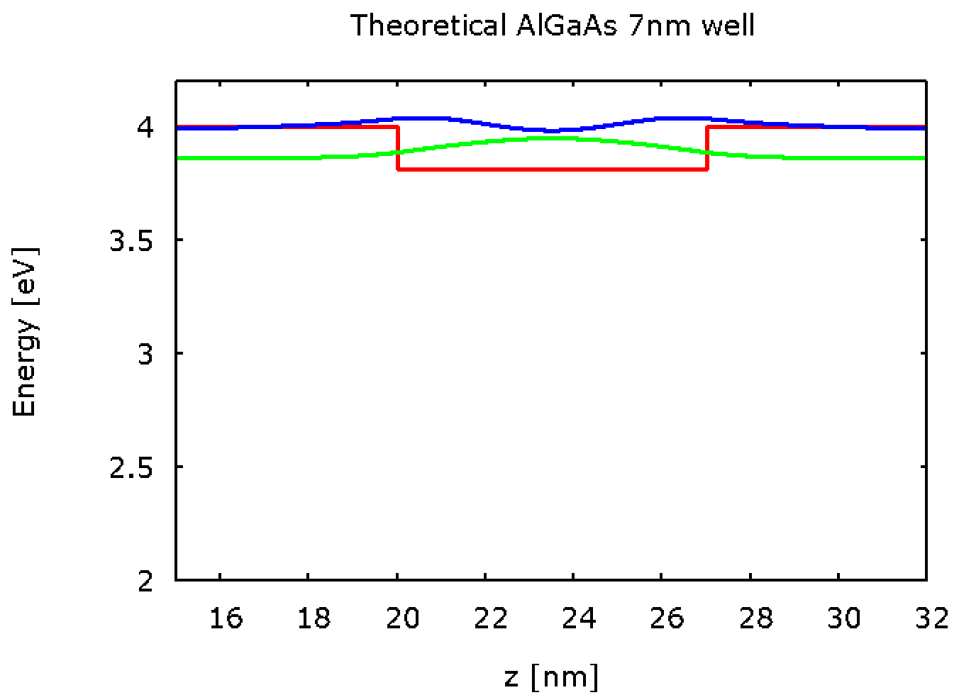
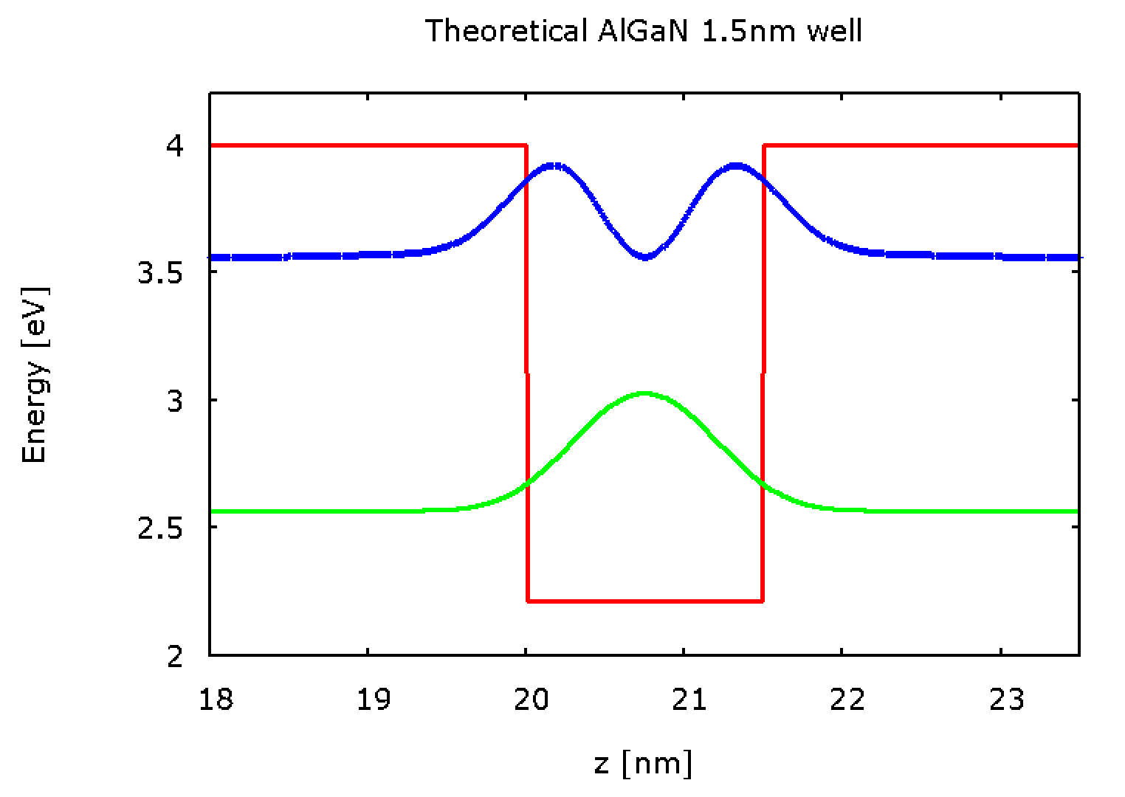
Spot the difference?
Quantum engineering following nature’s lead: using genetic algorithms to develop nitride optoelectronic nanodevices
AlGaAs
GaAs
AlGaAs
AlN
GaN
AlN

Slide 17
Spot the difference?
Quantum engineering following nature’s lead: using genetic algorithms to develop nitride optoelectronic nanodevices
~ 0.12 eV
~0.99 eV
AlGaAs
GaAs
AlGaAs
AlN
GaN
AlN

Slide 18
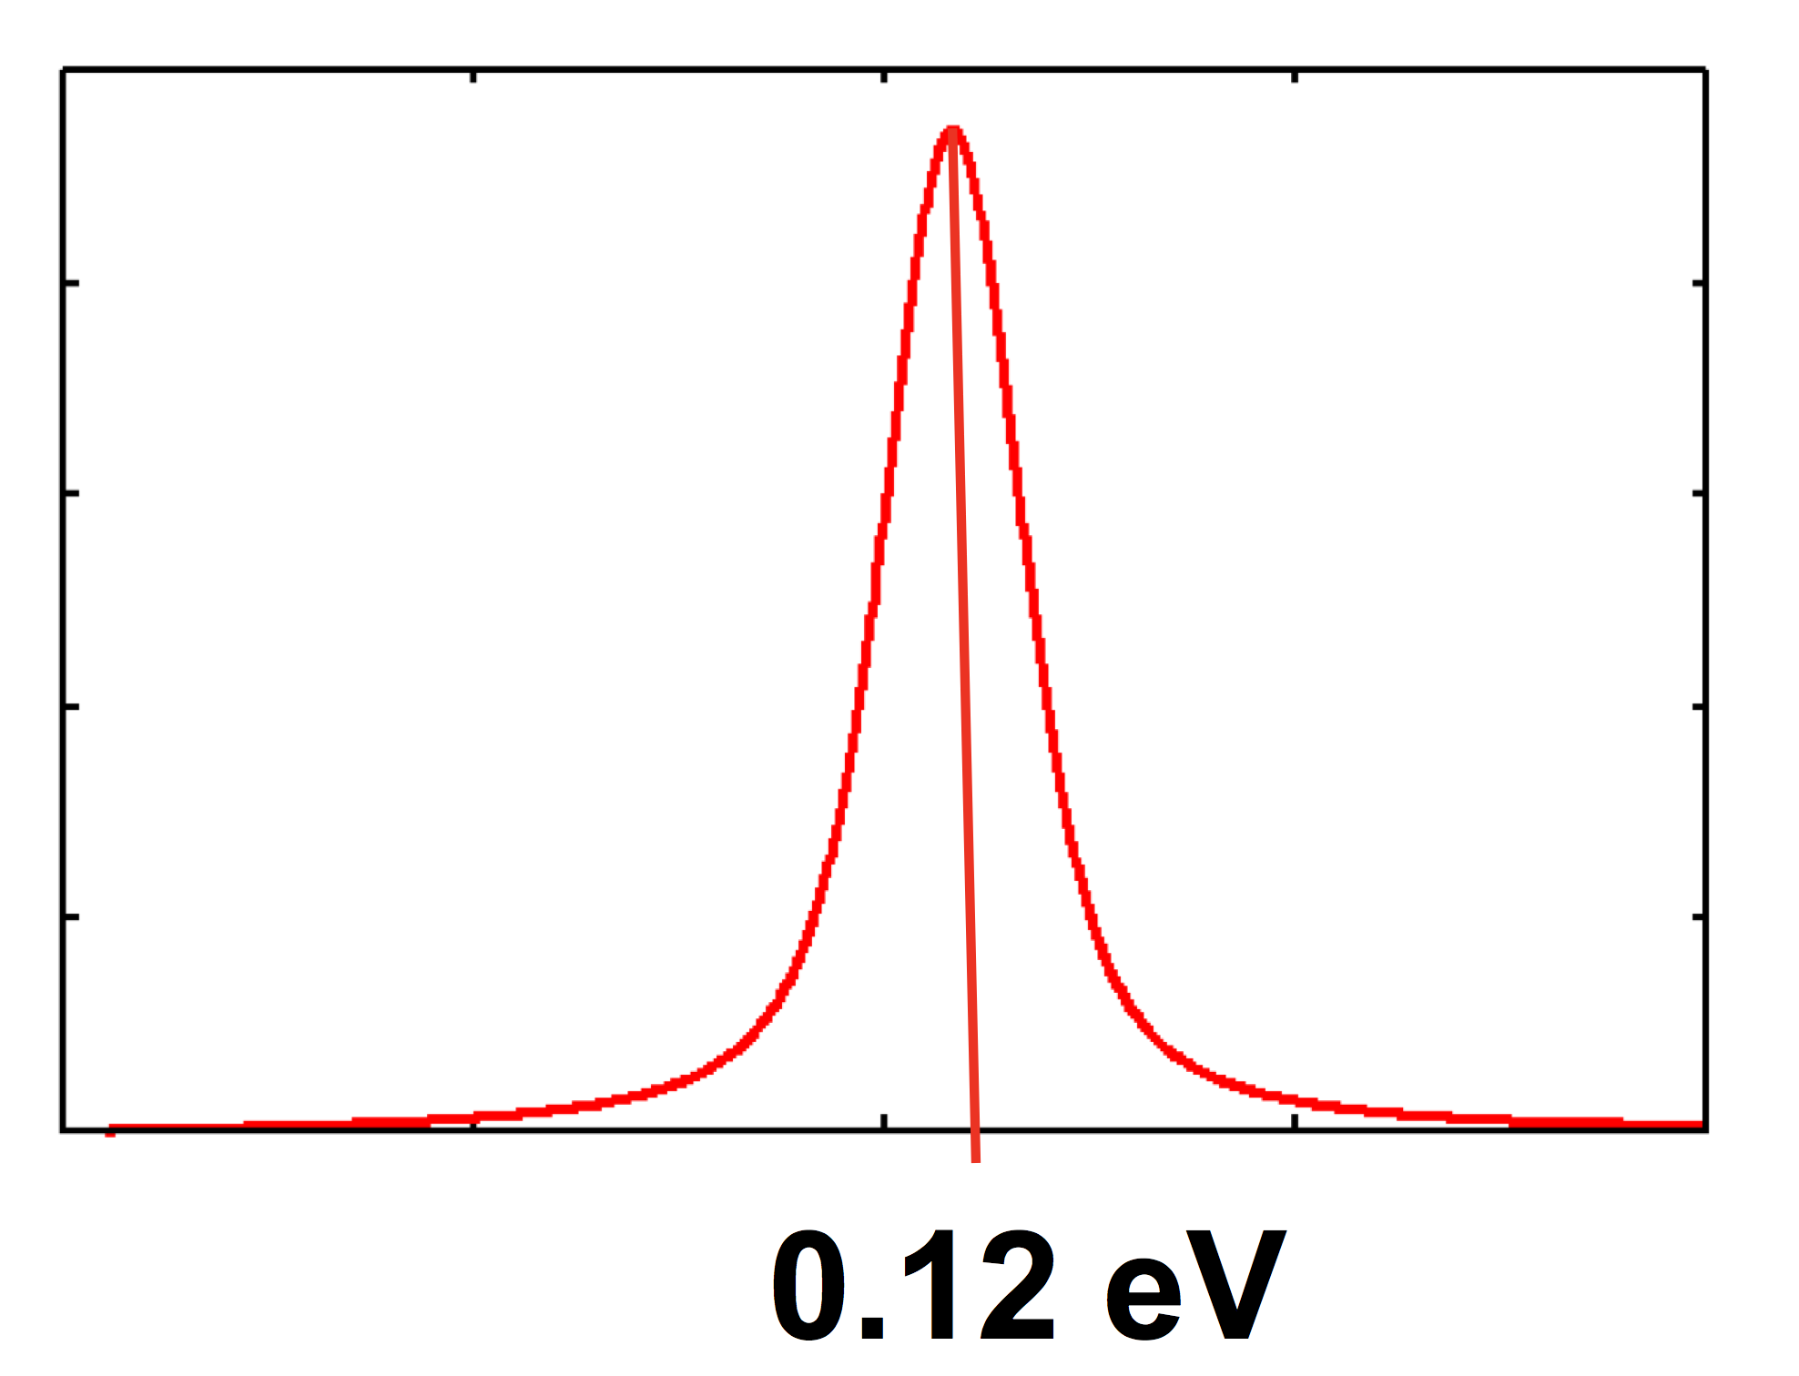
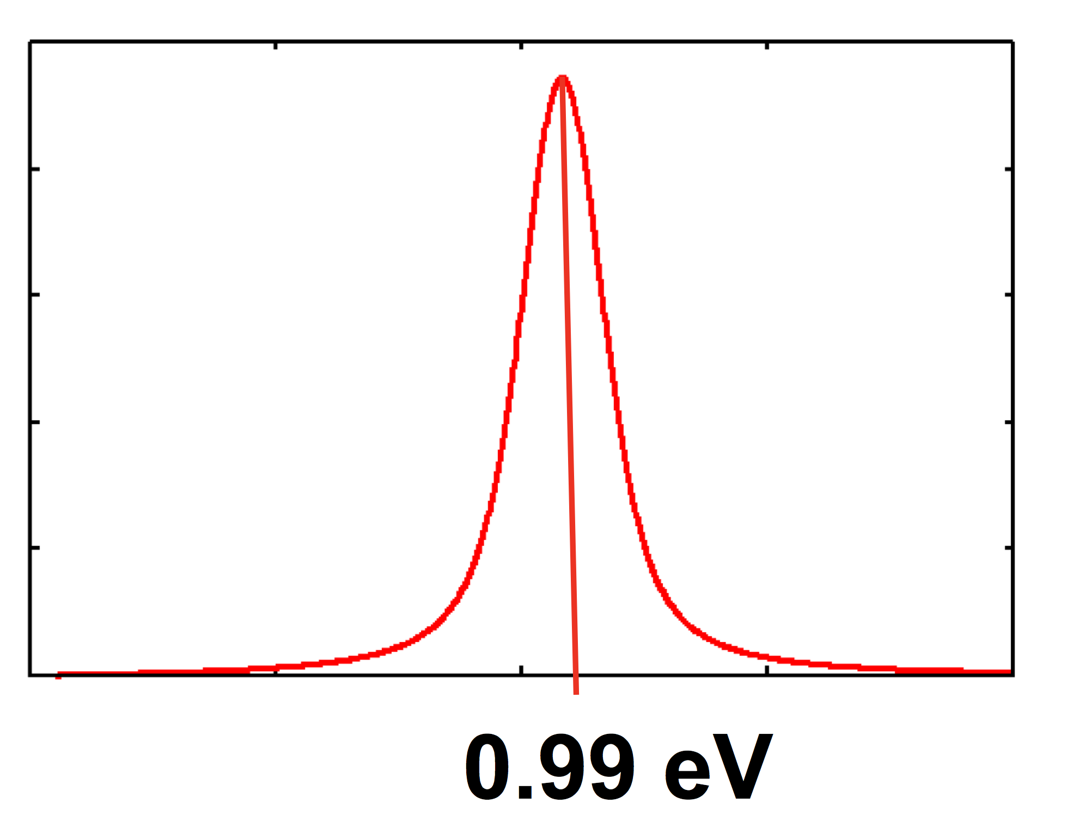
What does this mean?
Quantum engineering following nature’s lead: using genetic algorithms to develop nitride optoelectronic nanodevices
~ 0.12 eV
~0.99 eV
AlGaAs
GaAs
AlGaAs
AlN
GaN
AlN

Slide 19
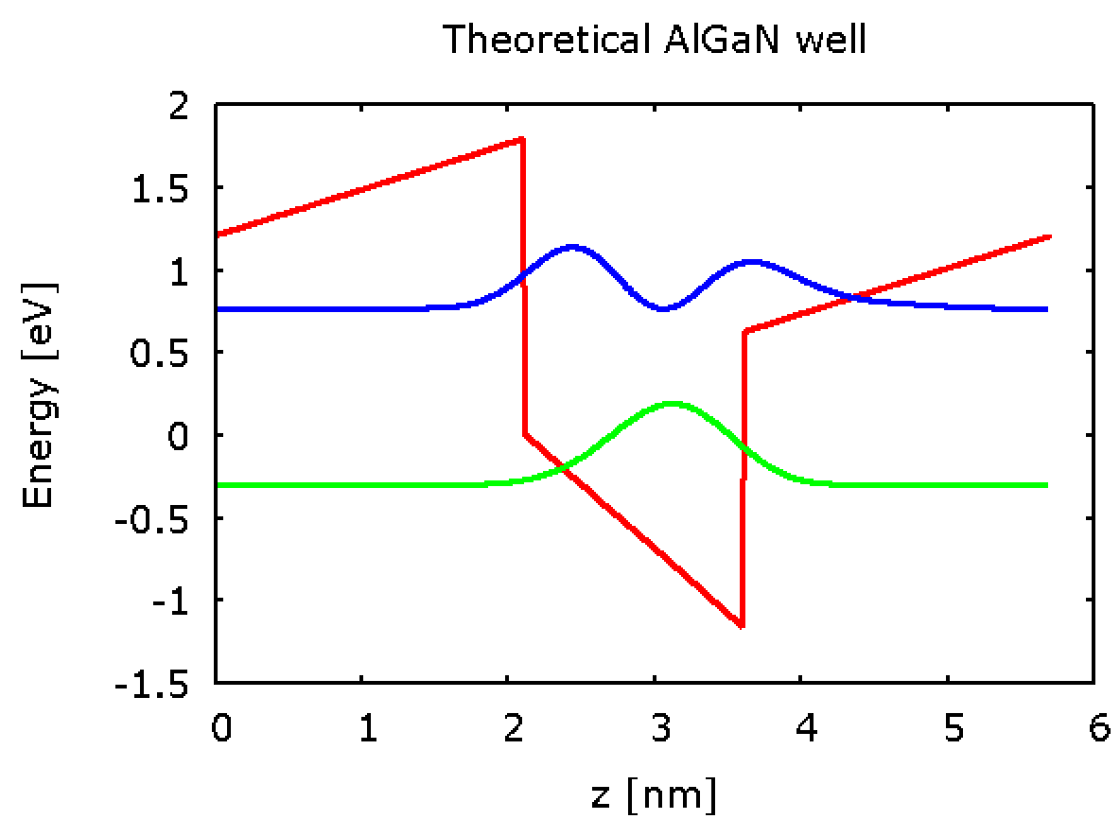
Internal field: not too terrible
Quantum engineering following nature’s lead: using genetic algorithms to develop nitride optoelectronic nanodevices
~1.06 eV
AlN
GaN
AlN

Slide 20
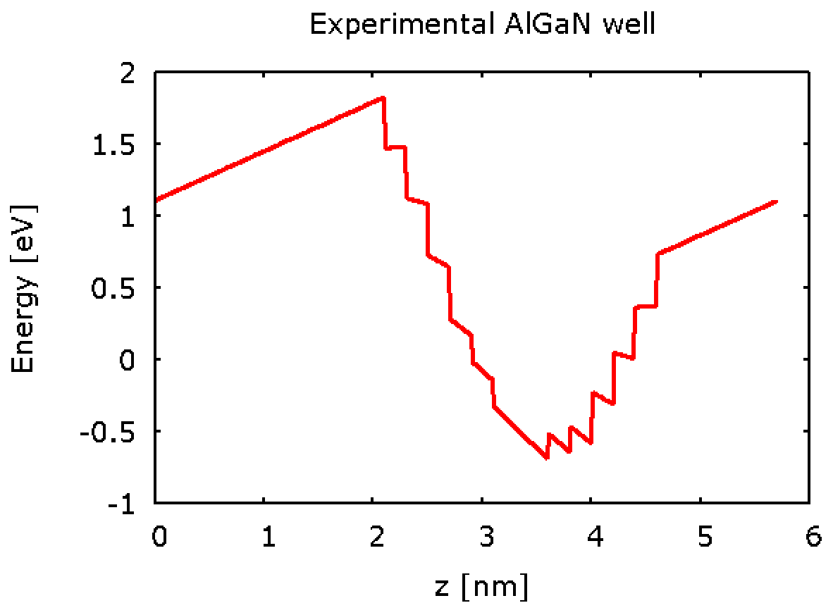
Theory vs Experiment: that doesn’t seem right...
Quantum engineering following nature’s lead: using genetic algorithms to develop nitride optoelectronic nanodevices
~1.06 eV
AlN
GaN
AlN
AlN
AlN
GaN

Slide 21
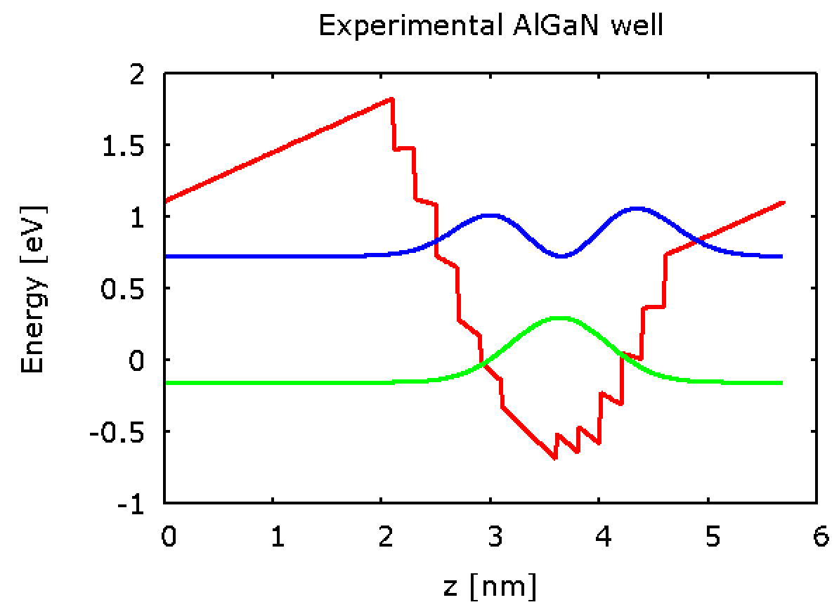
Theory vs Experiment: that doesn’t seem right...
Quantum engineering following nature’s lead: using genetic algorithms to develop nitride optoelectronic nanodevices
~1.06 eV
~0.88 eV
AlN
GaN
AlN
AlN
AlN
GaN

Slide 22
Predictive Modeling
Which design will give the wanted result?
???
???
???
Hard to determine if translation between theory and experiment is not straight forward.
Are there consistent deviations that could be accounted for?

Slide 23
Quantum engineering following nature’s lead: using genetic algorithms to develop nitride optoelectronic nanodevices

Slide 24
What is a genetic algorithm?
Quantum engineering following nature’s lead: using genetic algorithms to develop nitride optoelectronic nanodevices

Slide 25
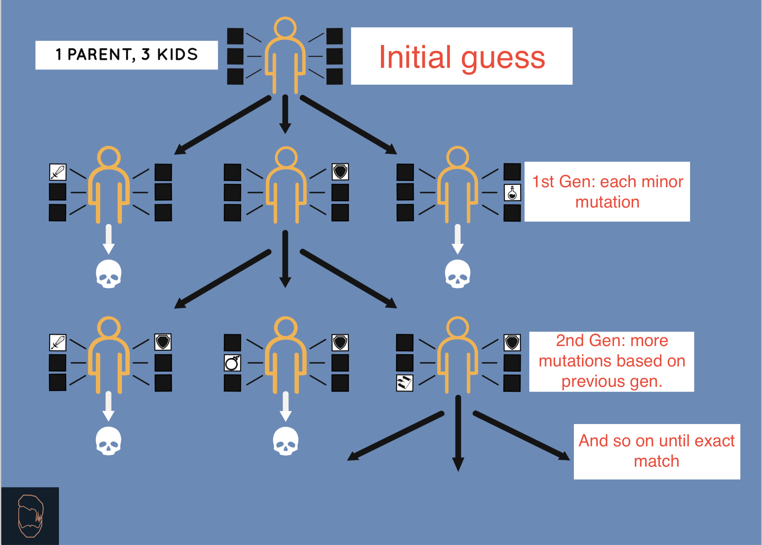
What is a genetic algorithm?
Quantum engineering following nature’s lead: using genetic algorithms to develop nitride optoelectronic nanodevices

Slide 26
Quantum engineering following nature’s lead: using genetic algorithms to develop nitride optoelectronic nanodevices

Slide 27

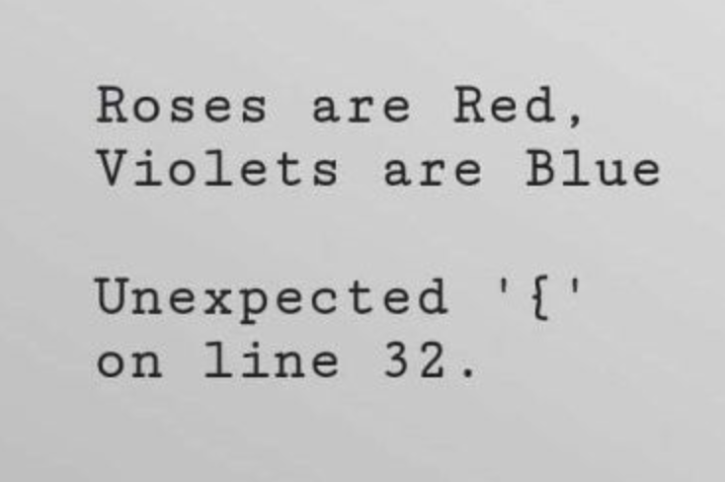


How did I spend the last year?

Slide 28
What did I implement?
Implemented genetic algorithm that can determines design that matches specific experimental result (absorption energy)

Slide 29
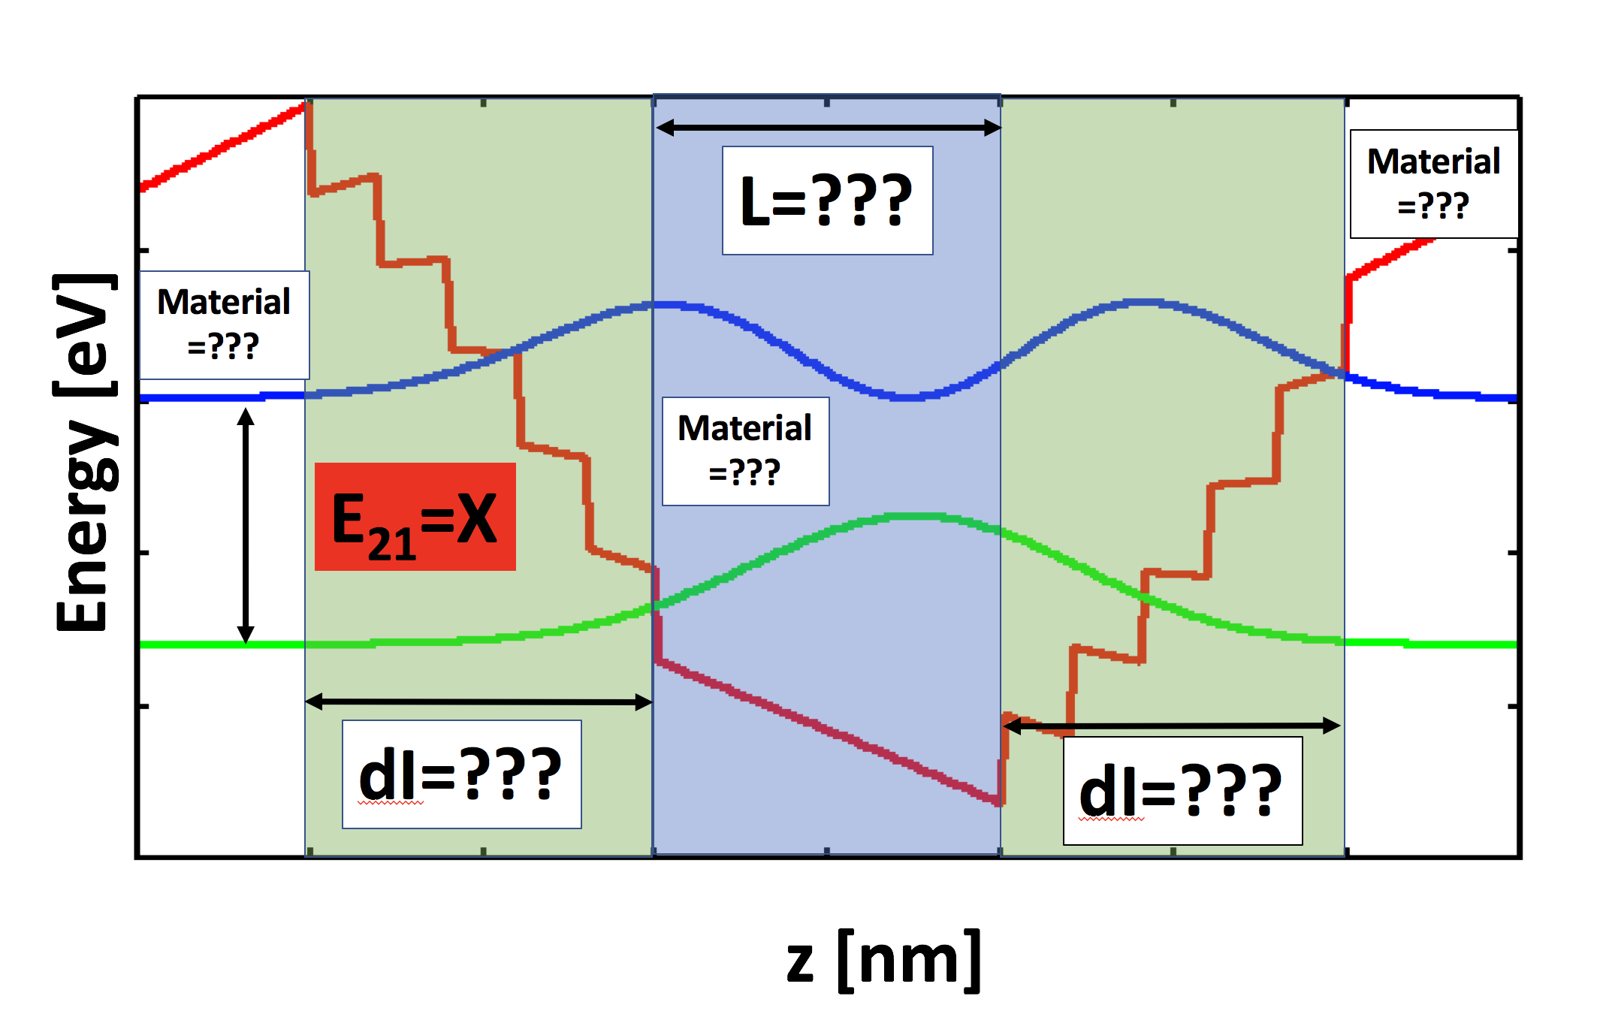
What did I implement?
Implemented genetic algorithm that can determines design that matches specific experimental result (absorption energy)

Slide 30
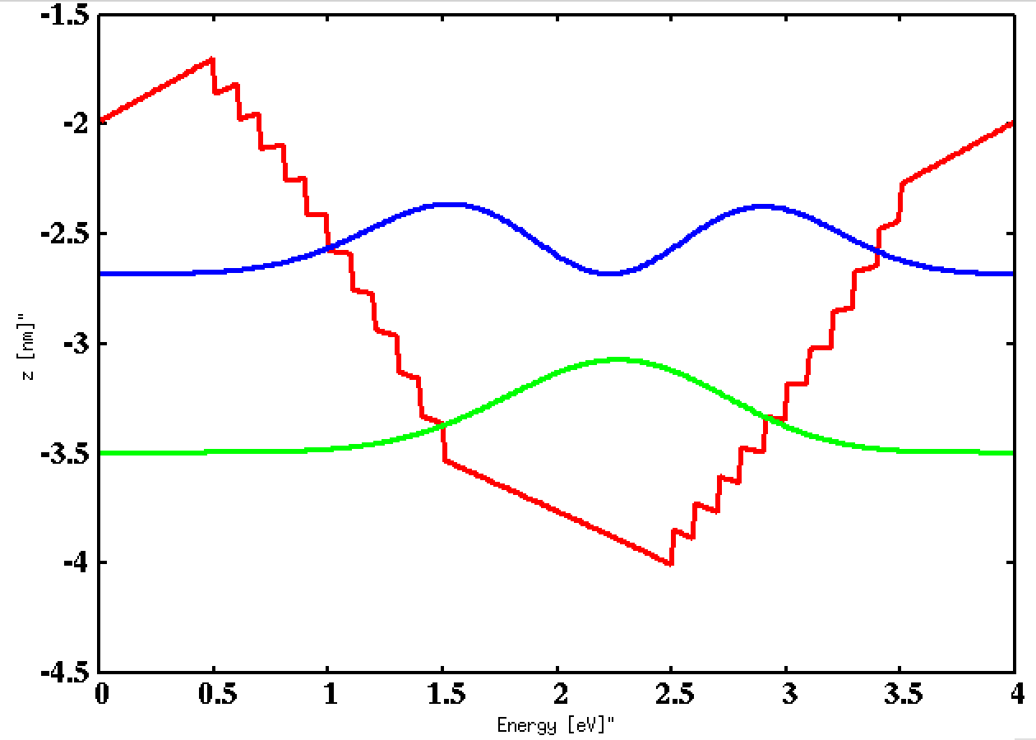

Specific example
Using genetic algorithm to determine well width and interface thickness to match absorption energy
0.813 eV
Energy [eV]
Z [nm]
L=2 nm, dI = 1 nm
Same Energy value

Slide 31
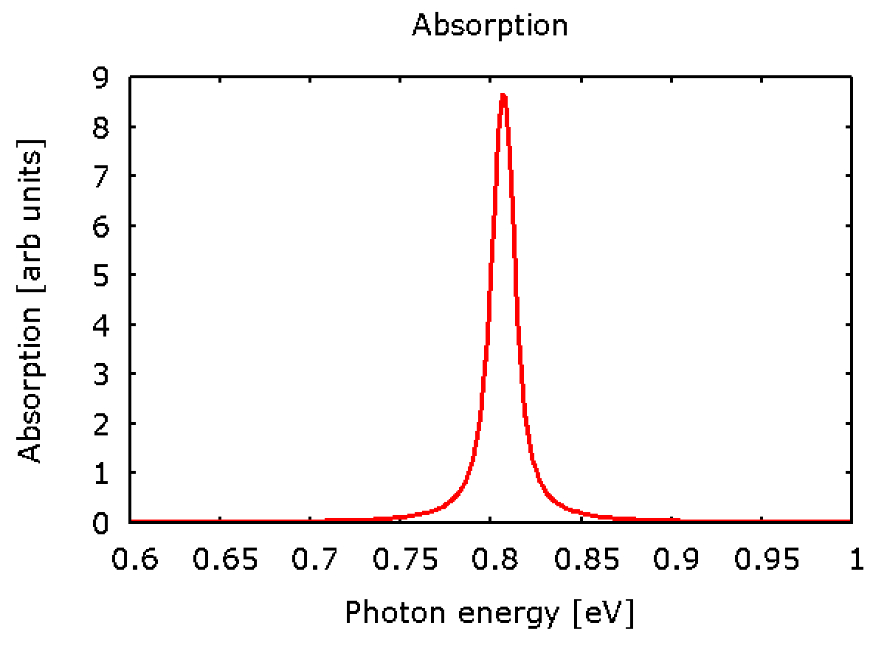
What comes next?
Use genetic algorithm to determine design that reproduces specific experimental result (i.e. absorption spectrum)
Study collection of experimental results to identify consistent deviations
to increase predictive modeling capabilities!

Slide 32
Acknowledgments
Dr. Inès & Gabriel Montaño
Christopher Coffey
NAU/NASA Space Grant
Mi Familia

Slide 33
Any Questions?

